Slide 1
Power Generating Plants

Slide 2
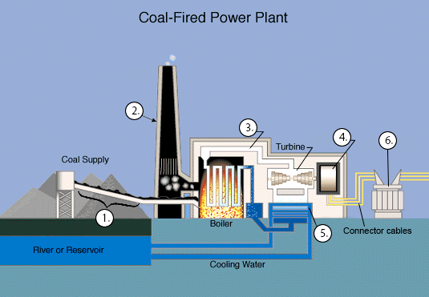
Coal, Oil, o Natural Gas fired plants

Slide 3
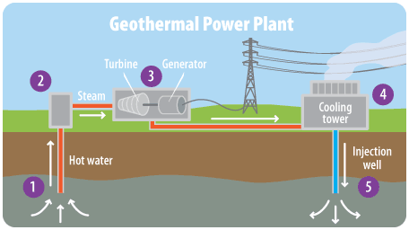
Geo Thermal plant

Slide 4
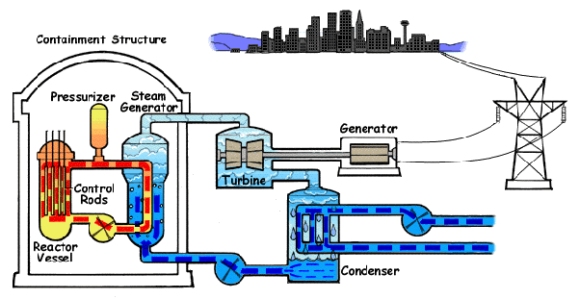
Nuclear Power Plant

Slide 5
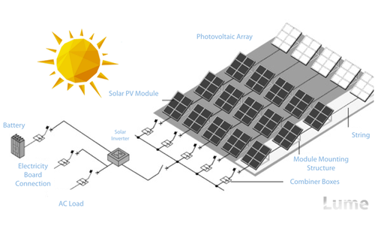
Solar Power (Photo-Voltaic cells)

Slide 6
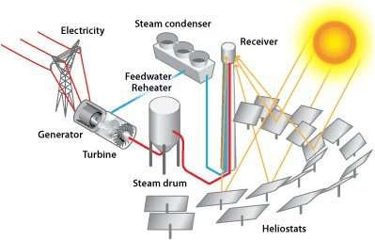
Solar power (Reflector-Collector style)

Slide 7
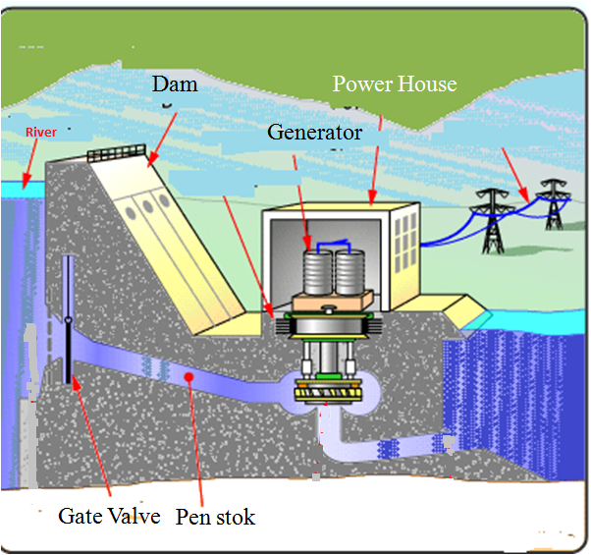
Hydro Electric Dam

Slide 8
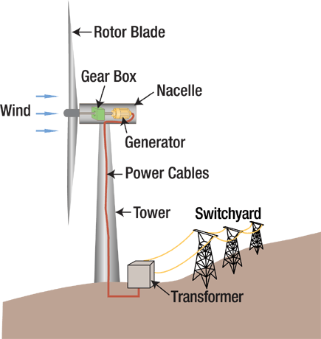
Wind Power Farm

